Slide 1

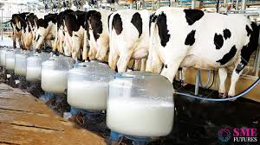
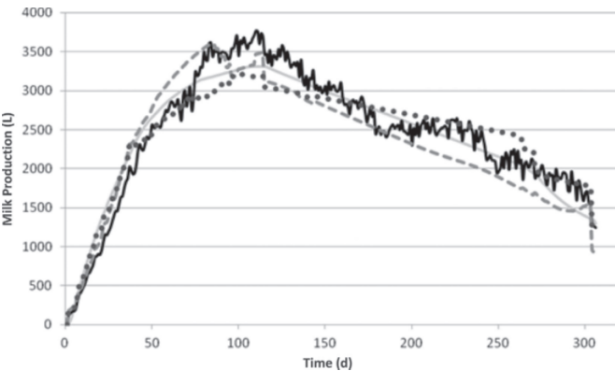


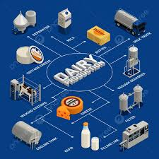
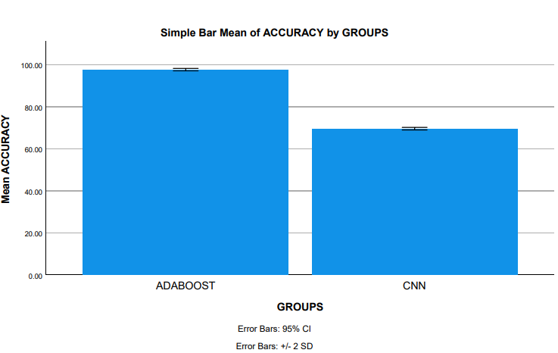
Name: Mr. P. Mourya Register Number: 192211771
Guided by Dr. K. V. Kanimozhi
Ms. Poorani.S
Guided by Dr. Mary Valantina. G
Efficiency of Predicting Milk Production Using Adaboost and convolutional neural networking
To Improve Accuracy.
INTRODUCTION
Real-time processes require accurate milk output, which requires forecasting the milk yield of cows. This is crucial for two reasons: first, to maximize farm revenue; and second, to predict the amount of milk that producers will need, so as to assure consistency. The main goal of this research is to forecast milk yield using the Adaboost approach.
we apply this strategy to compare the expected total milk yield with the actual output. We use the percentage that separates the actual output from the prediction to determine performance. Milk production plays a crucial role in the agricultural economy of many nations, serving as a primary source of livelihood for millions of farmers worldwide.
The aim of this study is to separate Innovative Machine Learning (ML) Classifiers to Efficient Predicting of Milk Production. The dairy industry also contributes significantly to economic growth and employment generation.
In this research study , Adaboost algorithm is compared with Convolutional neural networking to enhance accuracy.
The advantage of Adaboost algorithm has proven to be faster when compared with CNN to enhance accuracy.
Efficient Predicting of Milk Production
MATERIALS AND METHODS
Analyze
Data
Data Preprocessing:
Sample set of input data
Train
Dataset
Data Collection
Test Dataset
Data collection:
Organized data collected.
Explore data
Split Data
Adaboost Model
Better accuracy:
Algorithm that gives better accuracy compare with others
Campare With CNN Model
Efficient Predicting of Milk Production.
Adjust Model
Parameters
Milk production rate
Result
RESULTS
The testing process of the trained model is done by passing the dataset which is reserved for training purpose. By this process the accuracy, performance and precision of the trained model is obtained.
The generative adversarial Adaboost Algorithm seems to perform better than Convolutional neural classifier in this study as indicated by the significant value of p=0.001 (p<0.05) is statistically significant for improving the milk production.
 | Group | N | Mean | Std. Deviation | Std. Error Mean
Accuracy | Adaboost | 10 | 97.5940 | .29387 | .09293
 | CNN | 10 | 69.5210 | .30867 | 09761
AdaBoost and CNN
Tabular form for Adaboost vs CNN
In the present work, Adaboost Algorithm is compared with Convolutional neural networking (CNN) and it depicts that the proposed algorithm gives more accuracy when compared with the rest.
DISCUSSION AND CONCLUSION
Based on T-test Statistical analysis, the significance value of p=0.001 (independent sample T - test p<0.05) is obtained and shows that there is a statistical significant difference between the group 1 and group 2, The group 1 is 1059 & the total sample size is 2118, The alpha 0.05 and beta is 0.2 and power is 0.2 .
Overall , the accuracy of the Adaboost Algorithm is 97.59 % and it is better than the other algorithms. The advantage of Adaboost algorithm has proven to be faster when compared with CNN to enhance accuracy. The accuracy of Convolutional neural networking (CNN) - 69.77%
From the work , it is concluded that the Adaboost algorithm attains the high accuracy when comparing with Convolutional neural networking (CNN) Machine Learning Algorithm in Predicting of Milk Production. This project aims to develop milk production utilizing advanced statistical and machine learning techniques.
The Adaboost algorithm's adeptness in handling high-dimensional data and its capacity to mitigate overfitting contribute to its superior predictive accuracy. Its ensemble nature, amalgamating predictions from multiple decision trees, lends robustness to the model, particularly crucial in the nuanced landscape of milk products.
BIBLIOGRAPHY
Cheelo, Tulumbe. 2019. Milk Production and Marketing Channel Decisions of Smallholder Farmers in the Zambian Milk Value Chain. Dral, Pavlo O. 2022. Quantum Chemistry in the Age of Machine Learning. Elsevier.
Food and Agriculture Organization of the United Nations. 2013. The State of the World’s Land and Water Resources for Food and Agriculture: Managing Systems at Risk. Routledge. 2021. The Impact of Disasters and Crises on Agriculture and Food Security: 2021. Food & Agriculture Org.
Genomic and Genetic Evaluation of Feed Efficiency and Stillbirth in Dairy Cattle. 2016.
Hankammer, Stephan, Kjeld Nielsen, Frank T. Piller, Günther Schuh, and Ning Wang. 2018. Customization 4.0: Proceedings of the 9th World Mass Customization & Personalization Conference (MCPC 2017), Aachen, Germany, November 20th-21st, 2017. Springer.
Kienzle, Josef, John E. Ashburner, and B. G. Sims. 2013. Mechanization for Rural Development: A Review of Patterns and Progress from Around the World. Food & Agriculture Organization of the UN (FAO).

